Slide 1
CSE347: Information System Analysis and Design
Section: 07

Slide 2
Presented By:
Group: 05
MD. Nazmul Hasan
ID: 2021-3-60-150
Shamima Sharmin Ananna
ID: 2022-1-60-148

Slide 3
Presented to:
Dr. Raihan Ul Islam
Associate Professor
Department of Computer Science and Engineering
East West University

Slide 4
Project:
E-Commerce Website

Slide 5
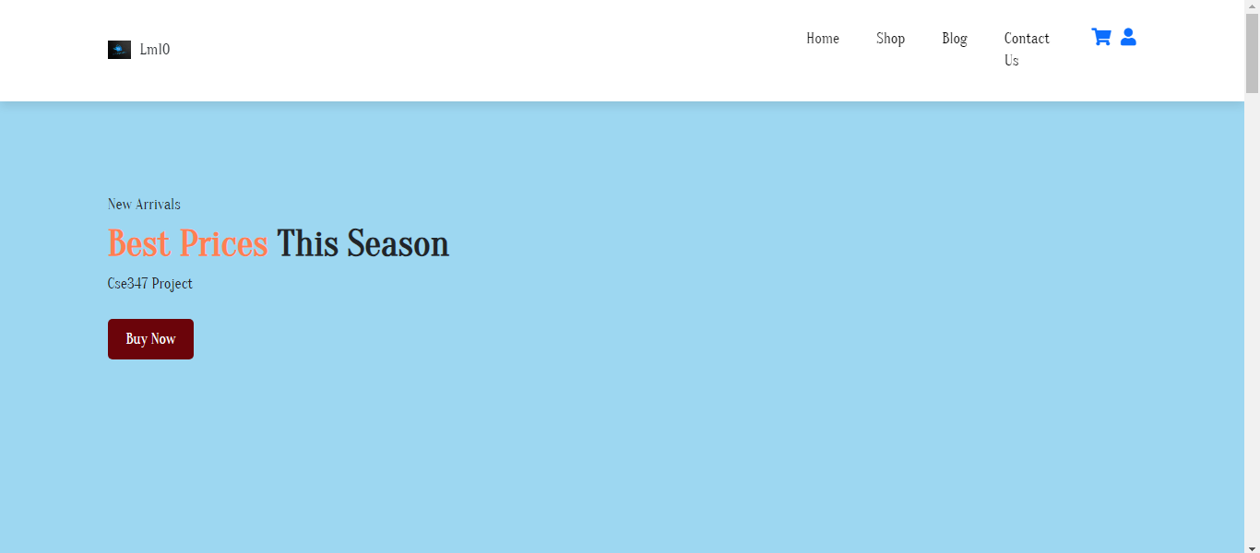
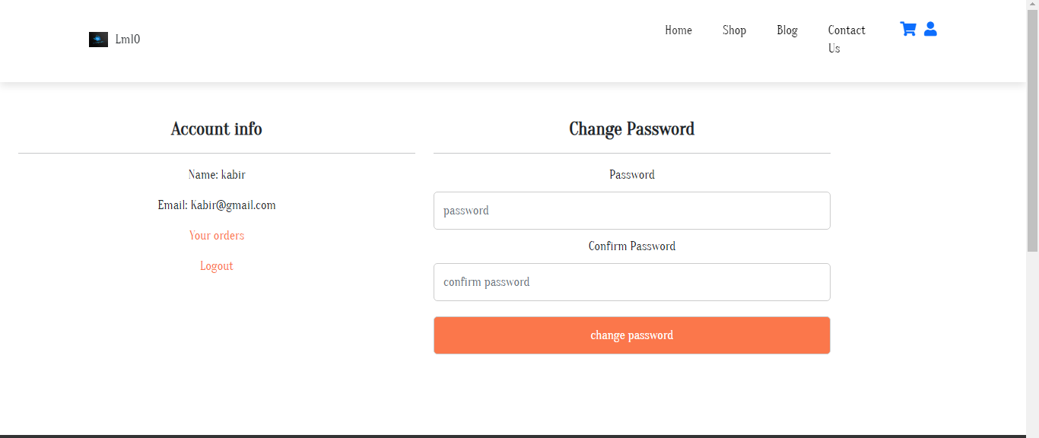

Slide 6
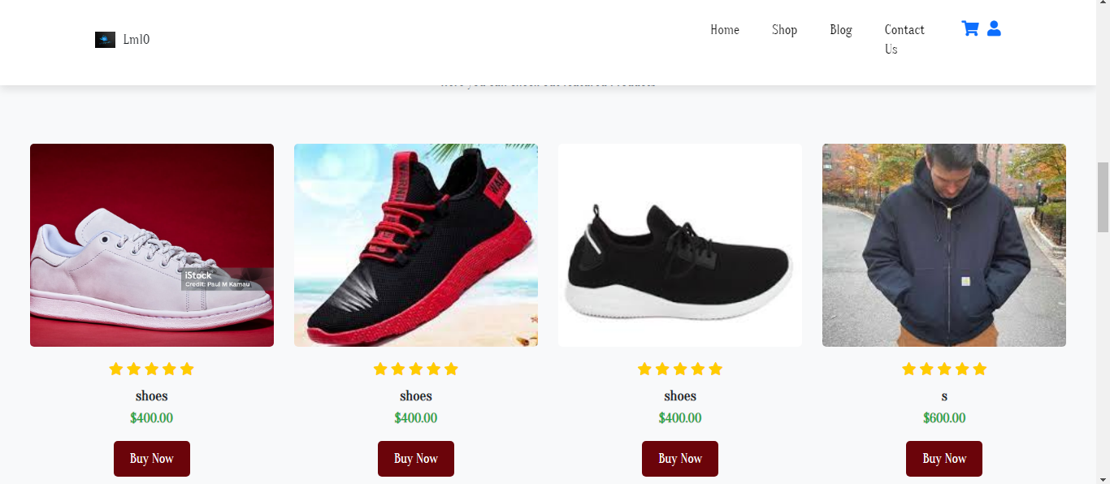

Slide 7
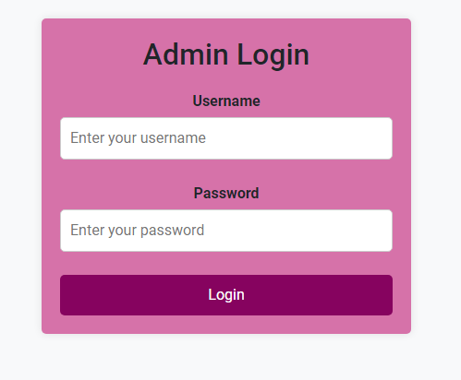

Slide 8
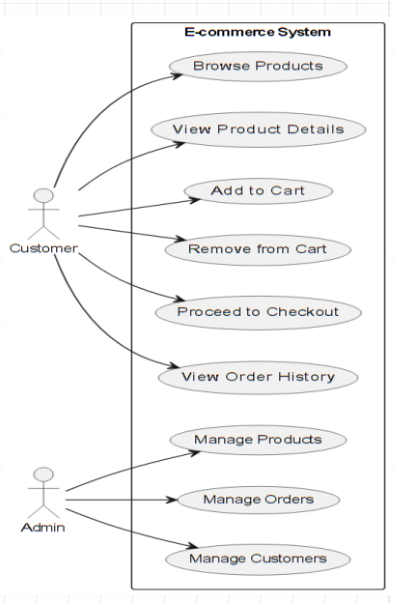
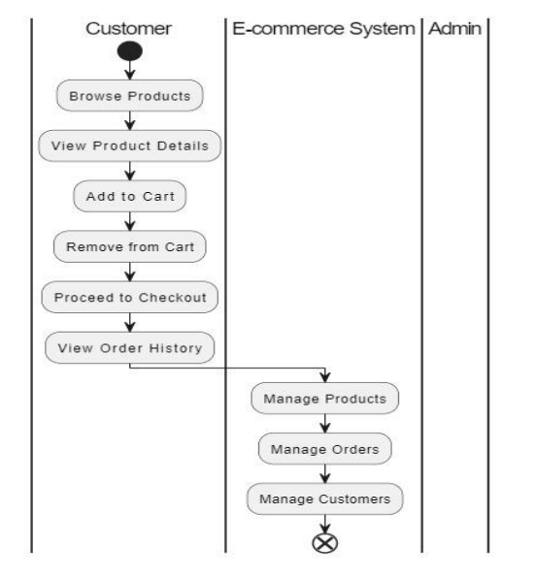
Use case Diagram

Slide 9
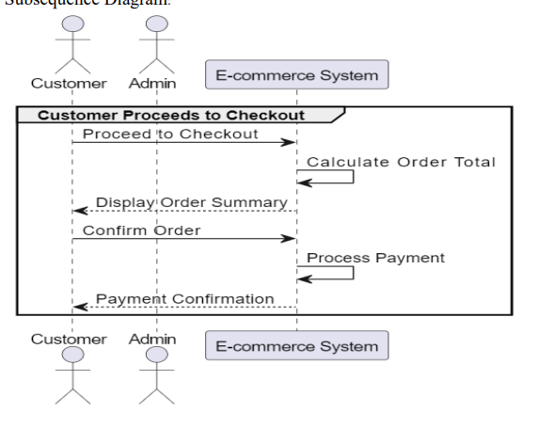
Subsequence Diagram

Slide 10
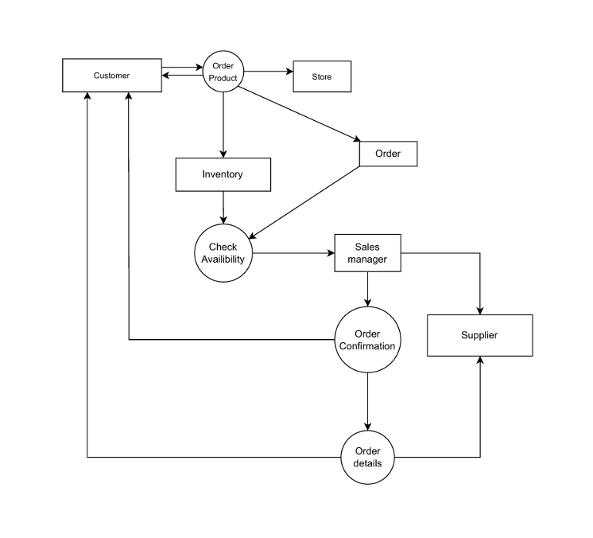
Data Flow Diagram

Slide 11
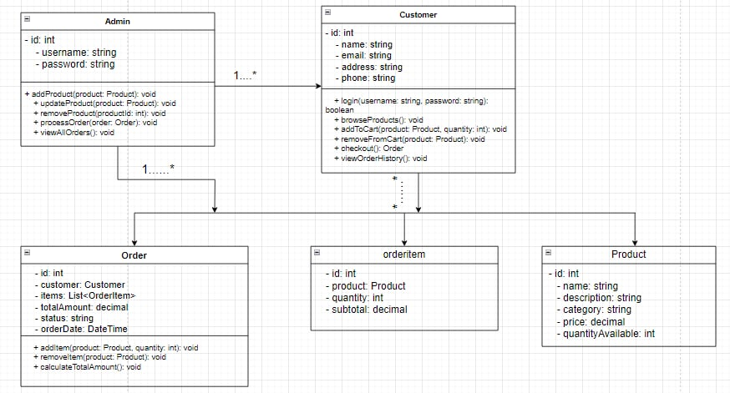
UML Diagram

